Slide 1
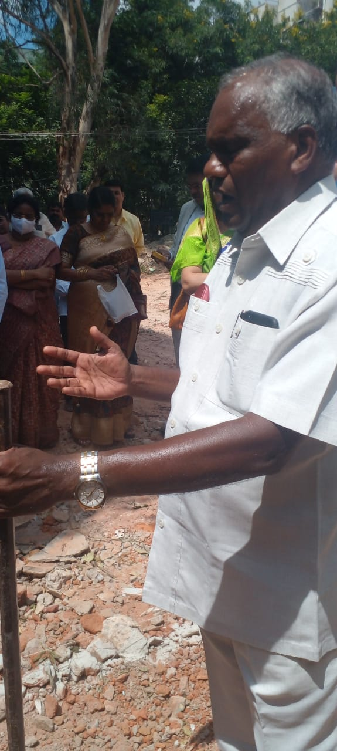
GROUNDBREAKING PRAYER MEETING FOR CONSTRUCTION OF SANCTUARY FOR REHOBOTH PRAYER HOUSE IN SR NAGAR, HYDERABAD ON SEPT 1ST, 2022
Ground Breaking by Anointed Servant of God namely Rev.Babu K.John of Full Gospel Church of God, New Delhi

Slide 2
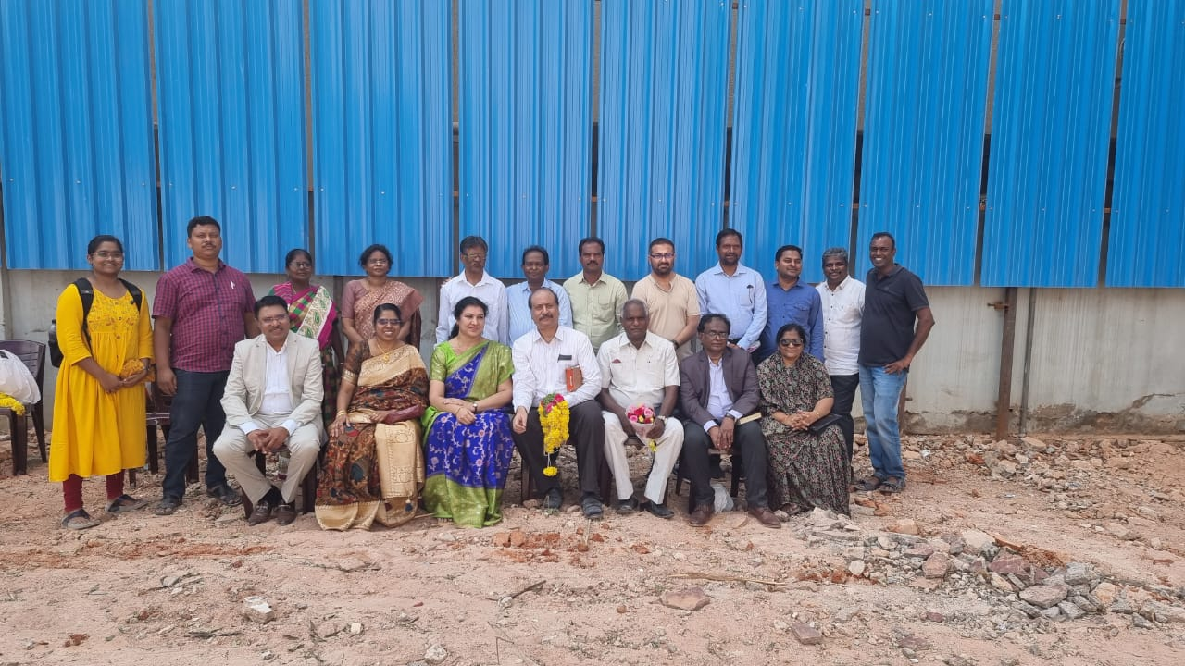
PARTICIPANTS IN THE GROUNDBREAKING PRAYER MEETING ON SEPT 1ST, 2022
Sitting left to right- Sanjay Isaiah of Ebenezar Society, Evangeline Sita of Ebenezer Society, Mrs Sheba Suresh, Pastor Suresh Manoharan,
Rev.Babu K.John Full Gospel Church of God, New Delhi , Rev Paul Prasad, Salem Fellowship,Mrs Mercy Paul
Standing left to right- Pratishta of Children of Light Church, Saran Moses, Mrs Sundari Jacob, Mrs Prasanna Kumar Raju, Pastor Samson Israel of Children of Light Church, Kumar Raju, T.Jacob, Ranjith Reynolds (the Builder), Joseph (Architect), Victor, T.Vijay, Vivekvardhan

Slide 3
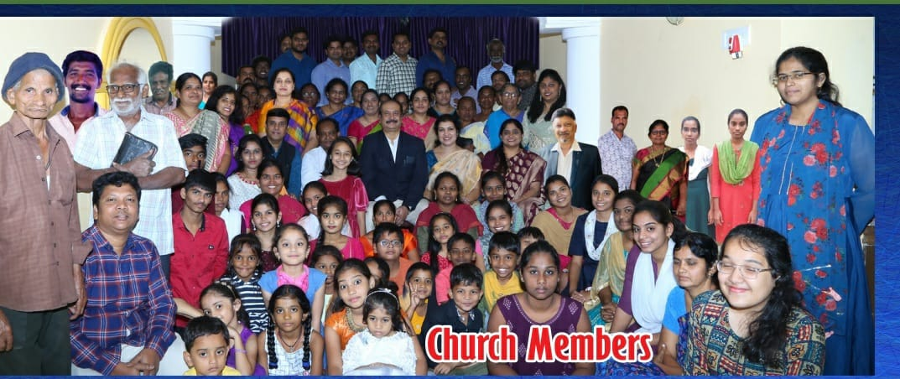
CHURCH MEMBERS

Slide 4
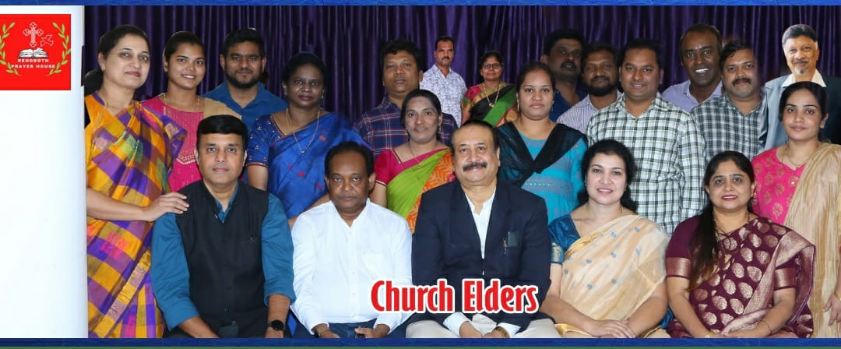
CHURCH ELDERS
Sitting left to right- Vijay Anand, Kumar Raju, Pastor Suresh Manoharan, Mrs.Sheba Suresh, Mrs.Jyothi Benoni
Standing Left to Right:- First Row: Mrs Mary Anand, Mrs Divya Rajshekar, Rajshekar, Mrs Prasanna Kumar Raju, Saran Moses, Mrs Karuna Moses,
Mrs Victor, Victor, Prashanth David, Mrs Karuna Prashanth
Last Row: T.Jacob, Mrs Sundari Jacob, Vishwa Teja, Venkatesh, Vivekvardhan, C.Benoni Richard

Slide 5
CHURCH YOUTH

Slide 6
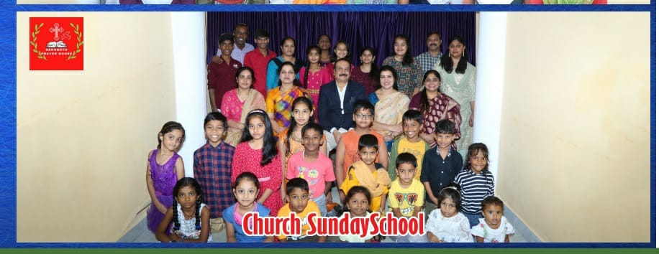
CHURCH SUNDAY SCHOOL (STUDENTS AND TEACHERS)

Slide 7
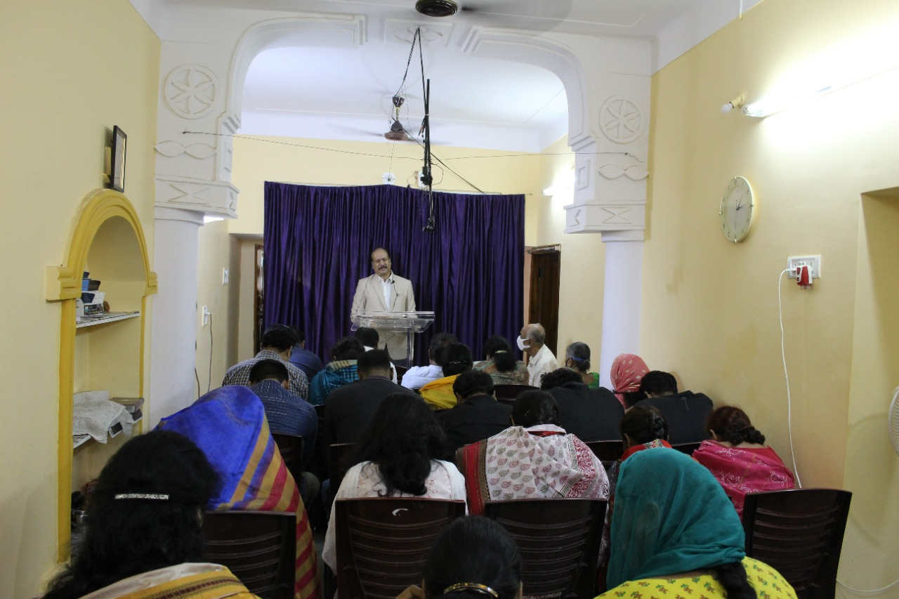
CHURCH SUNDAY SERVICE IN PROGRESS-VIEW FROM BACK

Slide 8
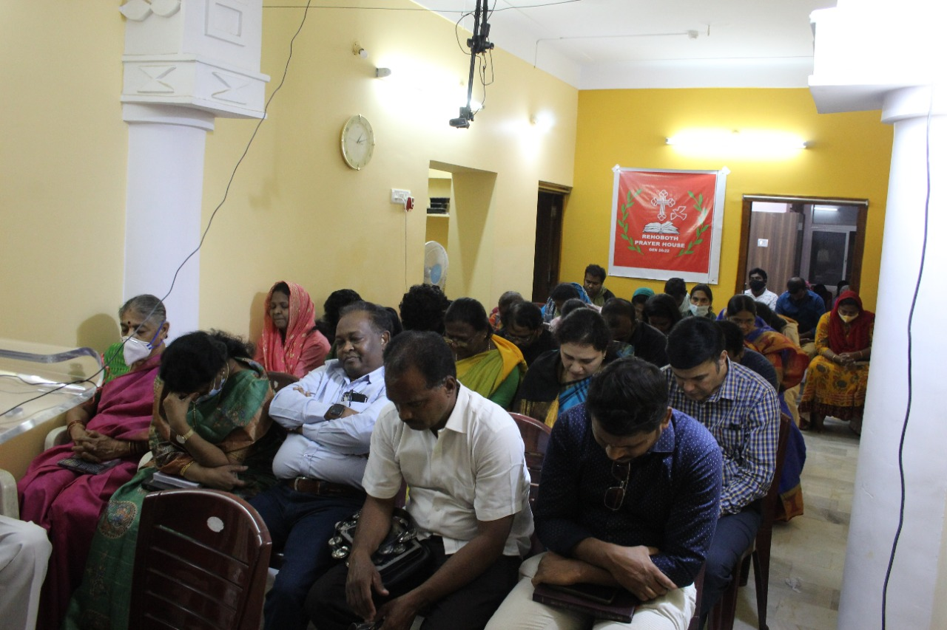
CHURCH SUNDAY SERVICE IN PROGRESS-VIEW FROM THE FRONT

